Slide 1



We build Careers
IT training program by
Iqra Technology

Slide 2

Introduction
Iqra Technology is an Information technology services and consultancy firm providing a broad portfolio of technology and business solutions with core expertise in Salesforce, Microsoft CRM, Web development, SharePoint, Angular JS, ASP Dot Net, Joget,Mobile Apps, Qlik Sense, Power Bi, Tableau, Oracle ERP, Ui Path (AI) and IT Outsourcing.
Headquartered in Aurangabad, India. Branches in Mumbai, and Nanded in India. Overseas office in UAE.
We are a team of 100+ Employees with comprehensive IT Industry experience.
We provide an excellent platform for fresher students to develop their careers in the IT sector.
As a part of CSR, we provide free IT training to undergraduates and graduate students with well-qualified and experienced team members. Our Vision is to provide a platform where students can enhance their careers and furnish a practical real-time training environment to apply theoretical learning into an actual working environment. We focus on developing skill sets that are recommended in the present market.

Slide 3
TRAINING PROCESS
TRAINING PATH
Foundation Training
C# ,SQL,(HTML, CSS Bootstrap)
Java Script
A candidate must pass any two examinations out of C#, SQL, JavaScript training courses
We will provide stipend based on seats available in a particular technology, Students can also select Technology of their choice and work on non stipend model
After passing the exam, deserving candidate will qualify for stipend seat ₹6000 and can enroll in one of our professional training
Experience staff are assigned as trainer. Foundation training is provided through online training sessions and videos.
Practice example and case scenarios are provided for practice.
Real life projects , cases studies and issues are provided to build and test students.
Work on International production projects.
PHASE 1
PHASE 2
PHASE 3
PHASE 4

Slide 4
Those who pass their first training and test will be allowed to attend further training
SQL
You're pursuing a SQL training
Passed
You need to attend all the session and tasks & passed out the tests
C#
Then only we allow you for further trainings
For example:

Slide 5

STIPEND ASSISTANCE
Students are free to select any technology for their career development.
We provide stipend assistance based on seat availability in a particular technology.
Rs 6000 stipend is provided per month to students who clear internal exams. Generally, students take 2- 4 months to clear the test. The stipend is guaranteed only for 6 months, students are expected to build their careers and vacate the stipend seat for another student after 6 months. Stipend Seat is provided in technology based on availability. Students can also select any technology without a stipend as per their choice.
We believe that best training can be provided on a project-based environment, hence we train students only on technology where we have projects to stimulate the real-life environment.
We provide internship certification to you after 6 months of training. If you complete the full-time internship training of 8 hours a day and 6 days in a week.
We do not provide any jobs.

Slide 6













Our TECHNOLOGY STREAMs

Slide 7
Who can apply for the trainings.
HSC passed students can apply.
Undergraduates and Post Graduates students can apply.
Students who are currently pursuing their Graduation & Master’s Degree can apply.
PEOPLE WHO ARE NOT ELIGIBLE FOR OUR TRAININGS
Part time & Full time working people can’t apply for our training.

Slide 8
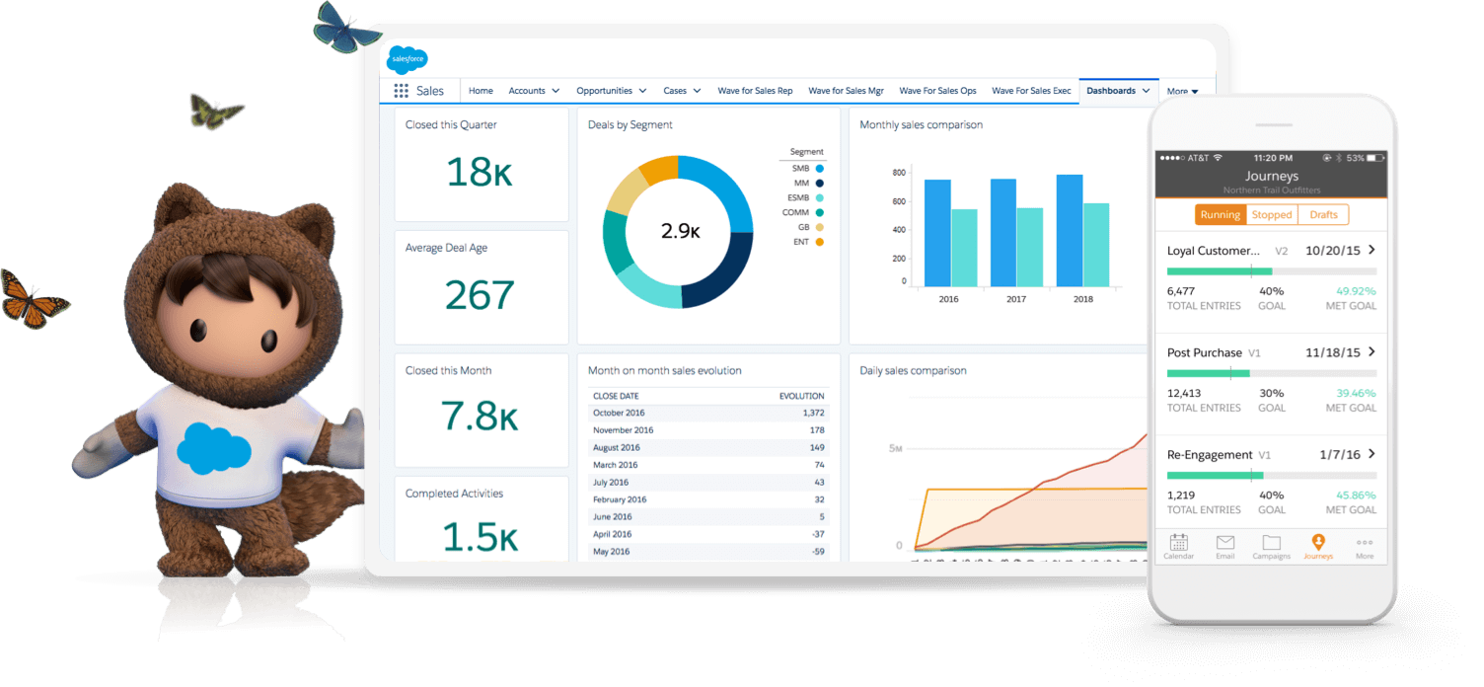
Salesforce
Salesforce is a cloud computing service and software company that specialization in customer relationship management(CRM). Salesforces services allow businesses to use cloud technology to better connect with customers, partner and potential customers.
The software is the number one CRM system and helps businesses track customer activity, market to customers and many more services. It is a complete product but it’s standard and it has an option to customized based on the company's requirement to achieve this CRM consultants are required.

Slide 9



Salesforce
Pre-requisites
Good English
JavaScript
SQL
Why Is It Easy To Learn Salesforce?
High quality video tutorials
Core system is designed in a way that students can learn and pick up skills quickly
System can be configured to meet end user requirement. One can easily and quickly create fields, forms, workflows, build restrictions, processes and reports without any coding
Time required
1 - 2 Years
Market Salary
Above 4 lakhs
/annum

Slide 10



Salesforce Training Path
SOQL training (Salesforce query language).
Visual page training ( Salesforce forms).
Integration training
Work and practice on real life projects.
Salesforce Development Training
( 9 months)
Salesforce Admin Basic to Advance level
(2 months)
Salesforce training videos and in-house developed videos.
Provide live test cases for practice.
Learn advance level functions.
Practice and build your admins skills.
Work on production ad real life projects.
Prepare for interviews.
Salesforce admin certification would cost to students and the rates will be vary in amounts
JavaScript Training
(4 Weeks)
JavaScript course will help you to learn basics to advanced concepts.
You’ll learn how to write and debug JavaScript code Objects, Functions, and Array, Regex how to use JS to change the CSS styles of HTML 5 elements, deal with HTML 5 forms and take on many more coding tasks.
Note :There is no job available in the market for an admin with 1 year of experience. Those who wish to take Salesforce admin training must first complete JavaScript training and pass the test. Then we can move them on to admin training.

Slide 11
Microsoft Dynamics CRM is a customer relationship management software package developed by Microsoft. It helps to develop leads, nurture contacts, track your sales, and keep your customers happy.
Pre-requisites
HTML,CSS,
JavaScript ,SQL
Why Microsoft Dynamics is good technology to learn?
One of the best CRM software.
Its available on cloud and on premises version.
Easy to learn as it is based on common set of technical skills like SQL, C#, HTML,CSS, JavaScript.
If students learn these technical skills can use their skills in other technologies like ASP.Net , Microsoft CRM etc
Time required
1 - 2 Years
Market Salary
Above 4 lakhs
/annum

Slide 12
Microsoft SharePoint is a browser-based collaboration and document management platform from Microsoft's content management system. It allows groups to set up a centralized, password-protected space for document sharing.
Pre-requisites
HTML,CSS,C#
JavaScript ,SQL
Why SharePoint is good technology to learn?
Part of Microsoft Technology .
Provides a platform to wide range of IT technology like web development, Angular etc.
Time required
1 - 2 Years
Market Salary
Above 3.5 lakhs
/annum

Slide 13
Angular is a platform and framework for building single-page client applications using HTML and TypeScript. Angular is written in TypeScript. It implements core and optional functionality as a set of TypeScript libraries that you import into your applications.
Pre-requisites
HTML,CSS,
Advance JavaScript
SQL
Why Angular is good technology to learn?
Angular is a google Technology.
Provides a platform for a wide range of IT technology like web development, Angular, etc.
Time required
1 - 2 Years
Market Salary
Above 3 lakhs
/annum

Slide 14
Qlik Sense , Power BI and Tableau are the top 3 Business Intelligence tool. These are Data Analytics Platform emerged in the market of Business Intelligence (BI) tools as a new-age technology which offers many user-friendly features. It is used by executives, decision-makers, analysts to explore the uncover insights that they can’t find with query-based BI tools.
Pre-requisites
SQL, Excel
Why Qlik sense is good technology to learn?
Easy and quick to learn
Technical knowledge of only SQL is required
Time required
1 - 2 Years
Market Salary
Above 3.5 to 6 lakhs/annum

Slide 15
UiPath is a Robotic process automation tool used for Windows desktop automation. It is used to automate boring repetitive tasks. It also eliminates the human intervention. With drag and drop functionality for all activities, it is the simplest RPA tool.
Pre-requisites
C#, Excel
Why UiPath is good technology to learn?
Its part of emerging Artificial Intelligence technology
Easy and quick to learn
Technical knowledge required is C# & Excel.
Time required
1 - 2 Years
Market Salary
Above 4 to 6 lakhs/annum

Slide 16

Other Technology
ORACLE ERP
Oracle ERP is a cloud-based software solution used to automate back office processes and day–to-day business activities. It is a business management software suite that includes financial management, supply chain management, project management, accounting, and procurement.
WordPress
WordPress is an excellent website platform for a variety of websites. From blogging to e-commerce to business and portfolio websites, WordPress is a versatile CMS. Designed with usability and flexibility in mind, WordPress is a great solution for both large and small websites.
Joget
Joget is an open source no-code / low-code application platform that combines the best of Rapid Application Development, Business Process Automation and Workflow Management. Joget empowers business users, non-coders or coders with a single platform to easily build, deliver, monitor and maintain enterprise applications.

Slide 17

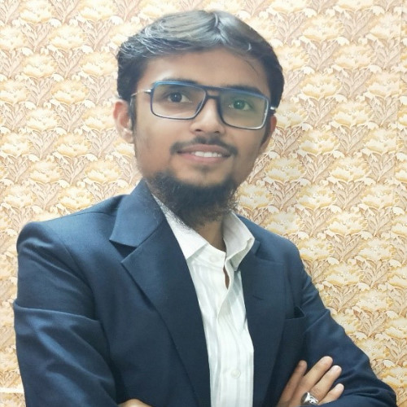
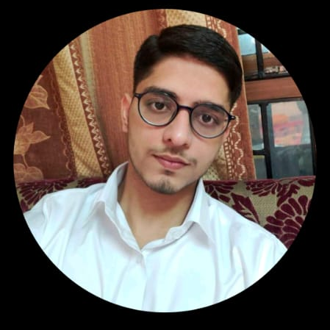





OUR STUDENT’S ACHIEVEMENTS
Mrs. Fehmida
Work duration with Iqra Technology 1 year
Job profile: Business Development Executive
Joined Company: Neosoft Technologies
Package: 5 Lac/Annum
Mrs. Nabeela khan
Duration with Iqra Technology for 5 years
Job profile: Senior Consultant
Joined Company: HCL
Package : 14 Lacs/Annum
Mr. Sayyed Manzar Ali
Work duration with Iqra Technology 3 years
Job profile: UI path RPA developer
Joined Company: Capgemini
Joined Package: 15 Lacs/Annum
Mr. Athar Choudhary
Duration with Iqra Technology 1.5 years.
Job profile : Salesforce Analyst
Joined Company : ENEL X (Mumbai)
Package : 5.00 Lac/Annum
Mr. Mohd Salman Khan
Duration with Iqra Technology 3 years.
Job profile: Dot Net developer
Joined Company: MITS Global
Consulting private LTD.
Package: 8.50 Lacs/Annum
Mr. Shah Alam
Work duration with Iqra Technology:2.7 years
Job profile: Dynamics 365 developer
Joined Company: Pragmysys Consulting
Package: 4.80 Lac/Annum
Mr. Avesh Lakha
Work duration with Iqra Technology 2 years.
Job profile : Salesforce Administrator
Joined Company : Diabsolut
Joined Package : 25.00 Lacs/Annum
Sayyed Amjad
Duration with Iqra Technology 2.3 years.
Job profile : Salesforce Developer
Joined Company : Finesse Global (Mumbai)
Package : 6.00 Lacs/Annum
Mr. Najeeb Syed
Duration with Iqra Technology: 1.4 years
Job profile: Salesforce Developer
Joined Company: Enquero
Package : 7 Lacs/Annum

Slide 18
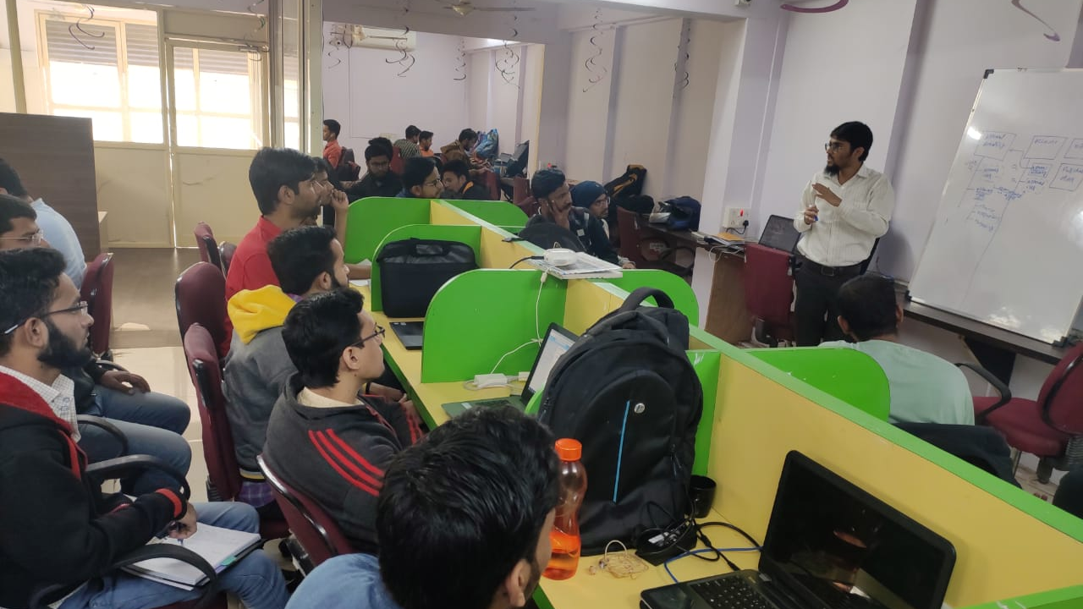
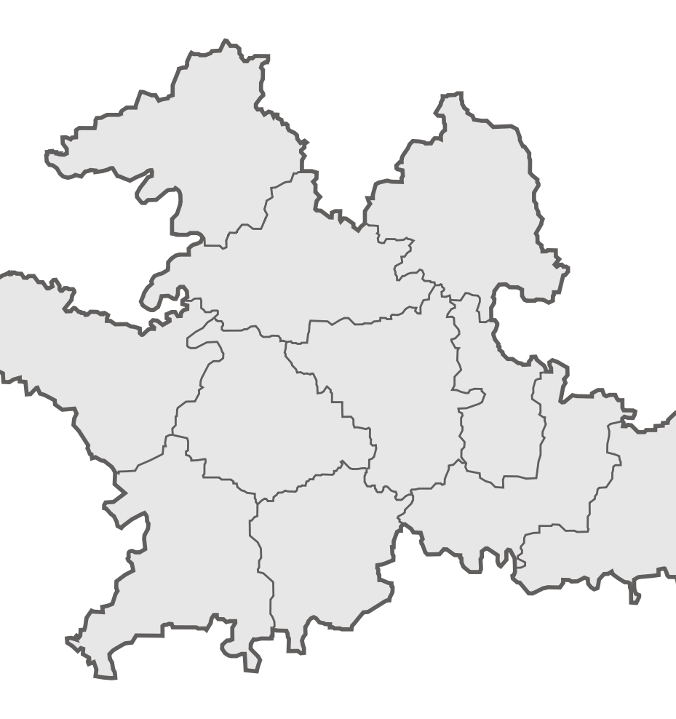
OUR TRAINING CENTERS
Aurangabad
Mumbra, Mumbai
Nanded
Note: If you are applying for any training, you must have a desktop and laptop along with you with good internet connection, skype, and zoom apps installed on it.

Slide 19

Power BI
Power BI is a collection of software services, apps, and connectors that work together to turn your unrelated sources of data into coherent, visually immersive, and interactive insights. Your data may be an Excel spreadsheet, or a collection of cloud-based and on-premises hybrid data warehouses. Power BI lets you easily connect to your data sources, visualize and discover what's important, and share that with anyone or everyone you want.
Tableau BI
Tableau is a powerful and fastest growing data visualization tool used in the Business Intelligence Industry. Tableau helps create the data that can be understood by professionals at any level in an organization. It also allows non-technical users to create customized dashboards.
Mobile Apps Development (Flutter)
Flutter is an open-source UI software development kit created by Google. It is used to develop cross platform applications for Android, iOS, Linux, Mac, Windows, Google Fuchsia, and the web from a single codebase.

Slide 20
For more details, you can follow us on our below social media handles
https://www.linkedin.com/company/iqra-technology/
https://www.instagram.com/iqra.technology/
https://twitter.com/technology_iqra
https://www.facebook.com/iqratechnology/
https://www.pinterest.com/iqratechnology/
https://www.youtube.com/channel/UCEtiVILXVLSG4QypzlSjMtw

Slide 21


“Thank you”
If you are interested to make a career in IT, reach out to Iqra Technology.
To join us please contact: training@iqratechnology.com
Or visit our website for online registration: https://iqraitacademy.com

